Slide 1

E6893 Big Data Analytics (Project ID: 201812-23)
Stock Performance Predictions based on News Analytics
Team Members:
Fan Gao (fg2432)
Connor Gatlin (ceg2195)
Ruisi Wang (rw2720)

Slide 2
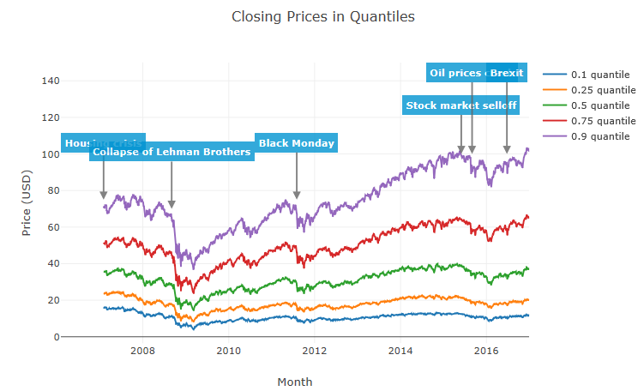
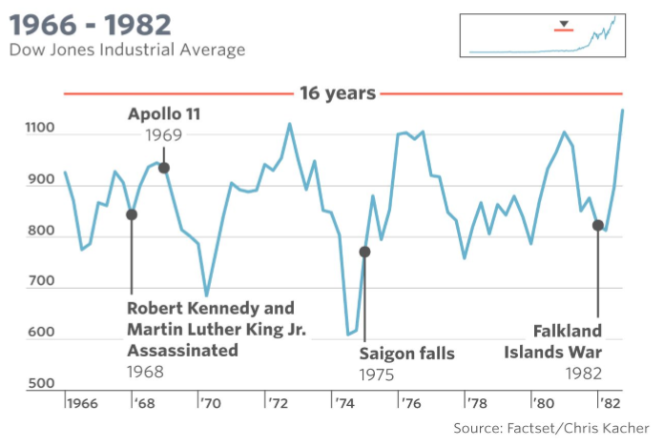
Motivation
Historically, news and stock performance are highly correlated
Understand the predictive power of news
Compare stock performance predictive models

Slide 3
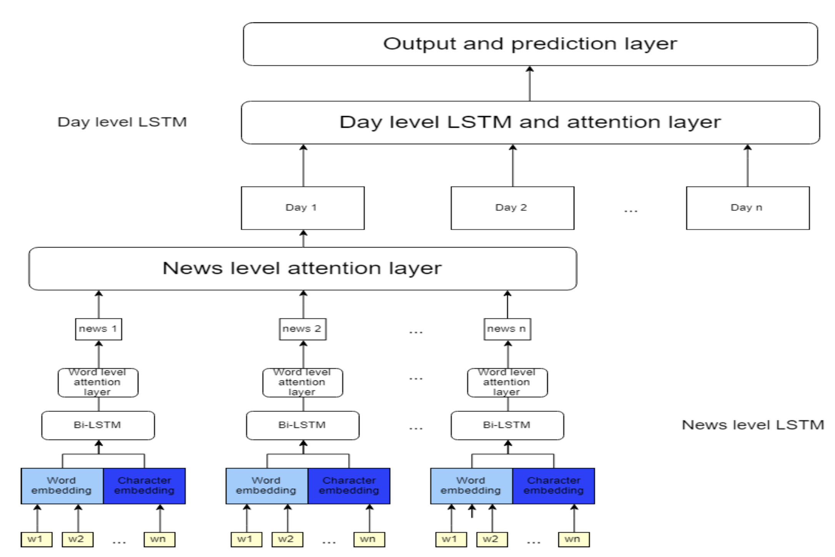
Related Work
Liu (2018) proposed an attention-based LSTM model (At-LSTM).
It predicts the directional movements of Standard & Poor’s 500 index and stock price of individual companies using financial news titles.
Results are competitive with the state-of-the-art model which incorporate knowledge graph into the learning process of event embeddings.
Joshi, Bharathi, Rao (2016) used polarity detection algorithm for initially labelling news and making the training set.
Based on this data, they showed that a tree-based model works very well for all test cases with accuracy ranging from 88% to 92%.

Slide 4
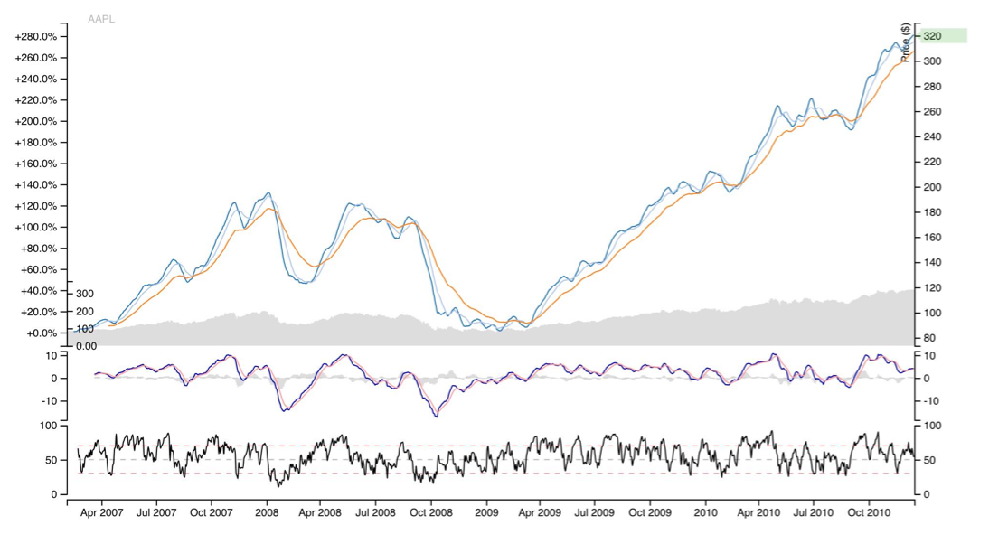
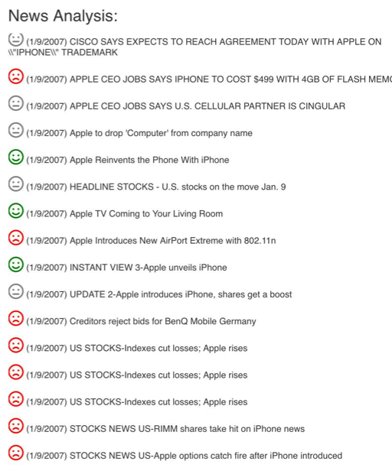
Datasets
Market data
2007 to present (4,072,956 samples - 1.2GB)
Provided by Intrinio
Stock Market data
Asset Code (Stock Ticker)
Open/close stock price
Trading Volume
Returns (1D, 10D)
Label - Future Return (10D)
News data
2007 to present (9,328,750 samples - 4.7GB)
Provided by Thomson Reuters
News articles and alerts published about assets
Headline
Asset Code mentions
Sentiment
Market Commentary

Slide 5










Tools
Languages/Packages:
Python, scikit-learn, pandas, nltk, DMTK LightGBM, Catboost
Visualization:
Node.js, d3.js, pyplot, matplotlib, seaborn
Platforms:
Jupyter Notebook, Google Cloud

Slide 6
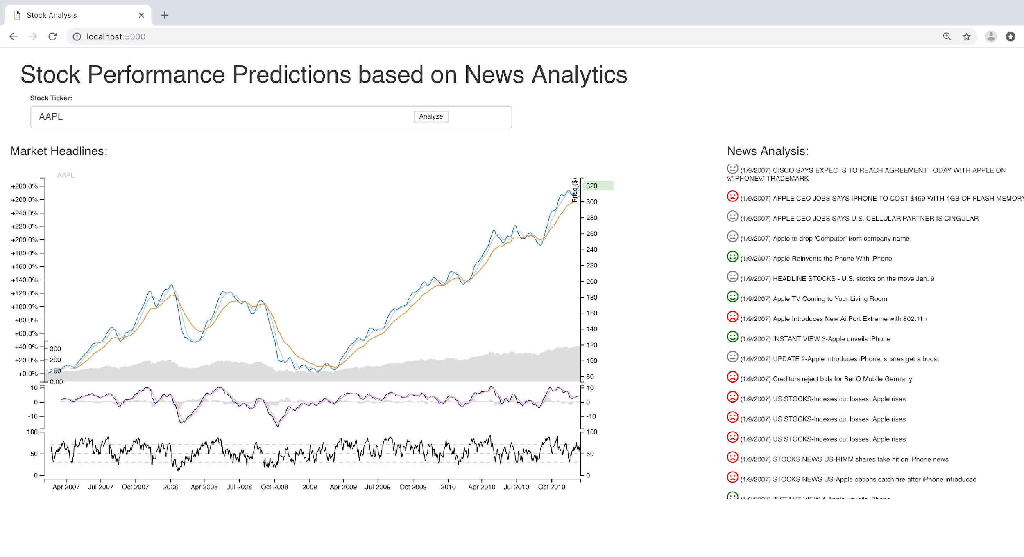
Data Visualization
Website

Slide 7
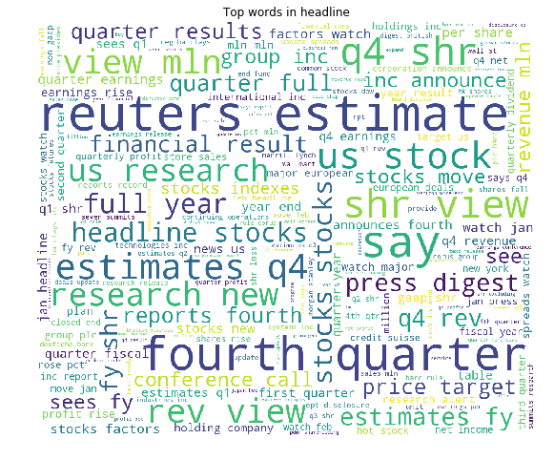
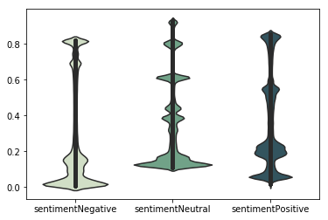
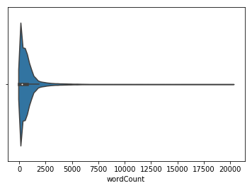
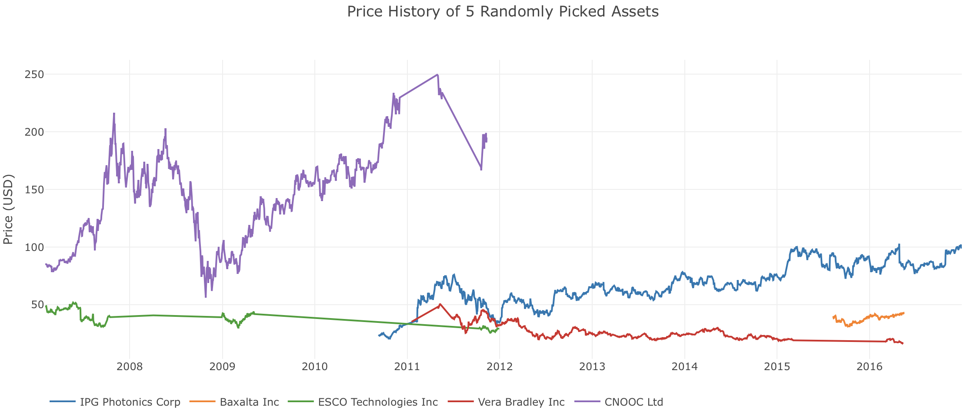
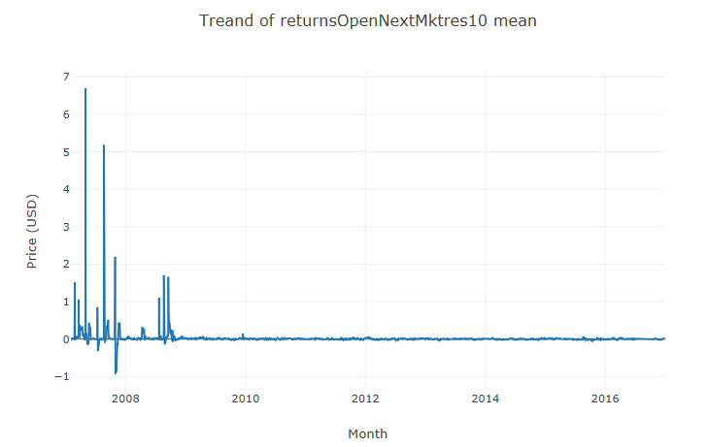
Data Exploration

Slide 8
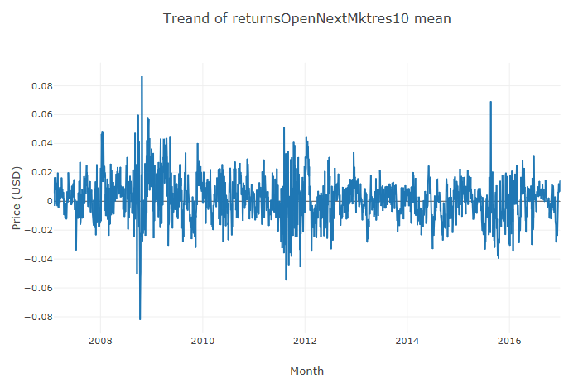
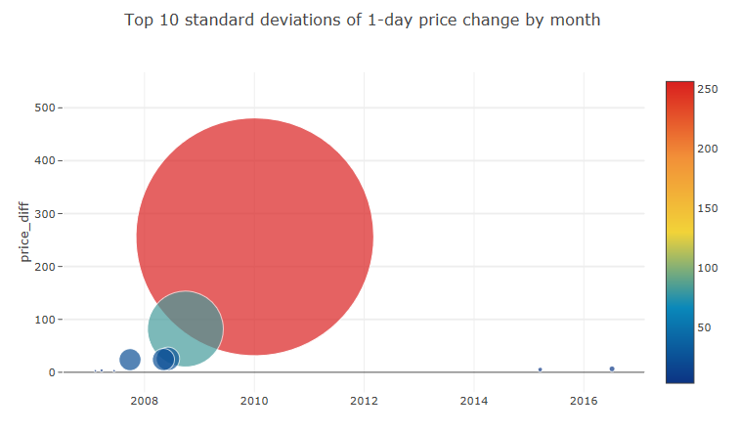
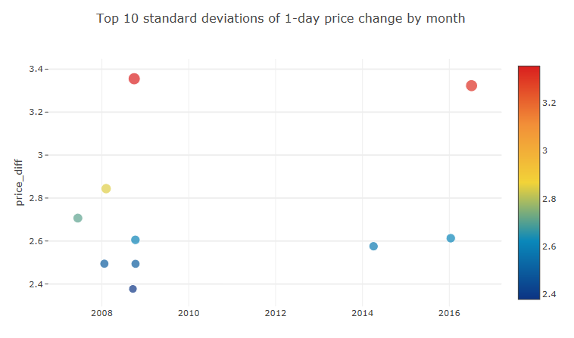
Data Preparation
Data Cleaning and Outlier Removal

Slide 9
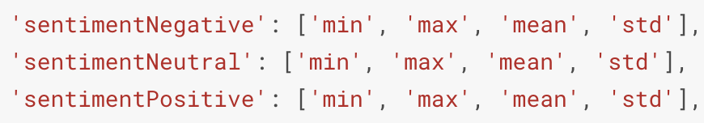
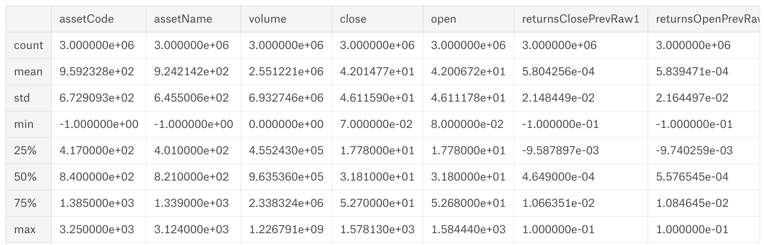
Feature Extraction
Market Feature Extraction
Extract derived numerical features
ex: close-to-open ratio, volume-to-average-volume ratio, etc.
Categorical feature encoding (assetCode, assetName)
News Feature Extraction
Convert headlines/subjects to numerical word vectors
Convert other categorical features to numerical
Flatten news articles to one row per day/assetCode
Data Merge
Flatten News Data and Merge with Market Data on “Asset Code” and “Time”
114 Features
4,072,956 Samples

Slide 10
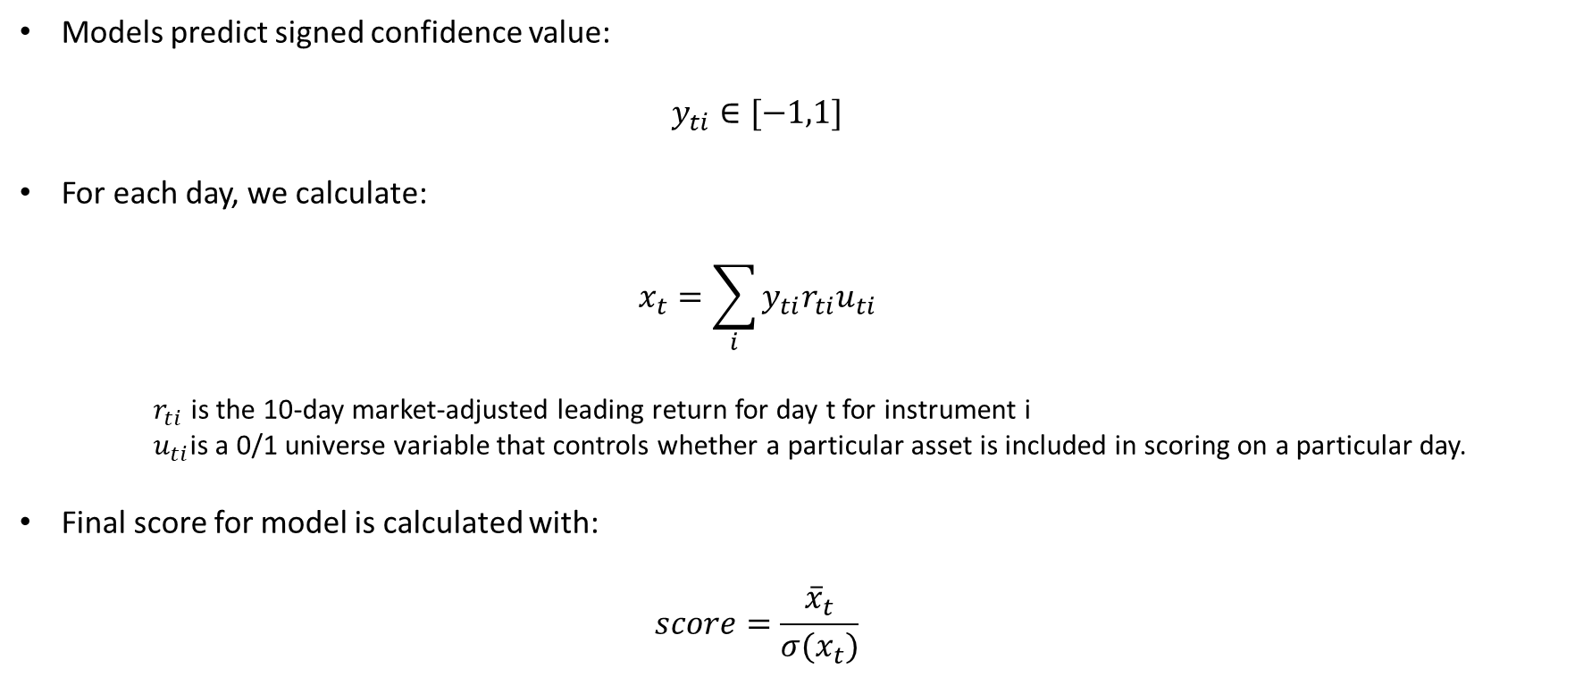
Modeling - Evaluation

Slide 11
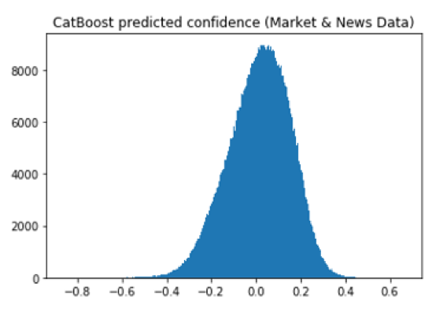



Modeling - Algorithms
Benchmark
Confidence values all equal to 1
Equivalent to buying all assets in the market on each day
CatBoost Classifier
Gradient boosted decision trees
Returns a confidence value
LightGBM Regressor
Gradient boosted decision trees
Returns an estimated 10 day leading return
LSTM Neural Network
Recurrent neural network
Beneficial for time-based series data

Slide 12
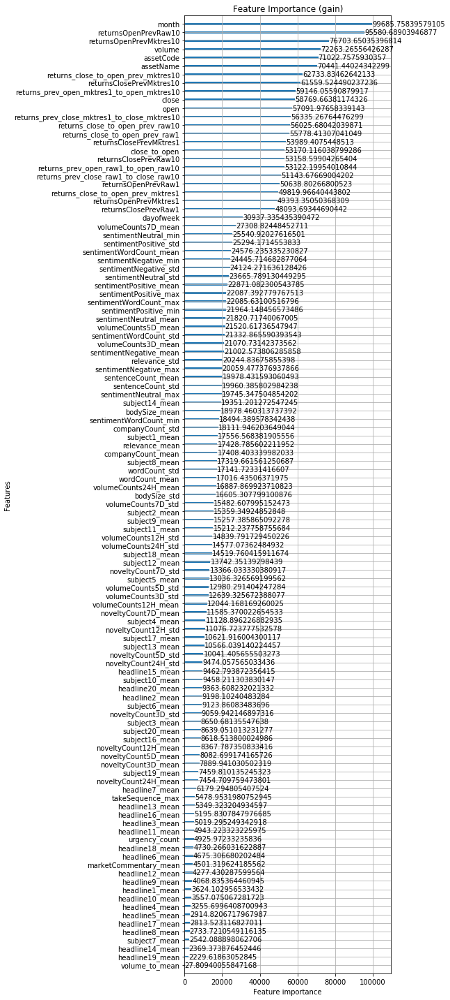
Results
LightGBM Regressor provided the best score on the test set
All models provided significant improvement over benchmark
Classification Model was improved by 34.9% with added news data
Training (70%) | Validation (20%) | Test (10%)
Model | Score on Test Data
Benchmark | 0.016
CatBoost Classifier w/out News Data | 0.630
CatBoost Classifier | 0.850
LightGBM Regressor | 0.916
LSTM Neural Network | TBD

Slide 13
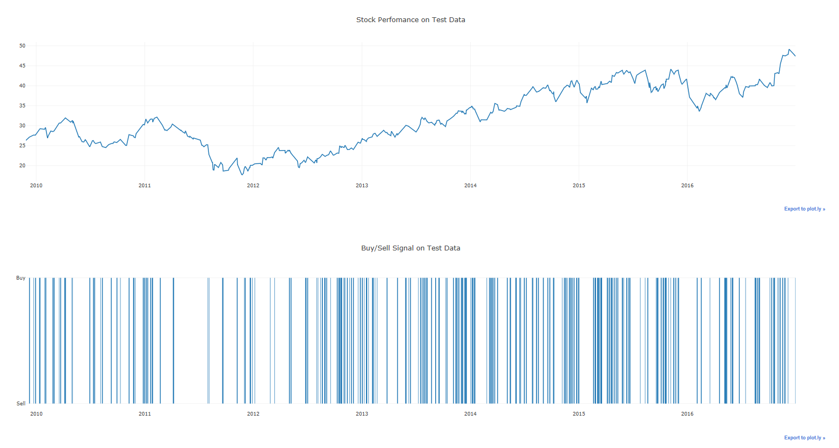
Results

Slide 14
Reference
Huicheng Liu. “Leveraging Financial News for Stock Trend Prediction with Attention-Based Recurrent Neural Network”. In: arXiv:1811.06173 (2018).
Kalyani Joshi, Bharathi H. N, and Jyothi Rao. “Stock Trend Prediction Using News Sentiment Analysis”. In: arXiv:1607.01958 (2016).
Liudmila Prokhorenkova, et al. “CatBoost: unbiased boosting with categorical features”. In: arXiv: 1706.09516v4 (2018).
Guolin Ke, et al. “LightGBM: A Highly Efficient Gradient Boosting Decision Tree”. In: Advances in Neural Information Processing Systems 30 (NIPS 2017) (2017).
Kaggle. “Two Sigma: Using News to Predict Stock Movements”. In: Featured Code Competition (2018).

Slide 15
YouTube Link
https://youtu.be/8oagRyBbris

